Slide 1
Butterfly
Nate Christiansen
Jake Wheeler
Nick kapty

Slide 2
System Features
The ability to play, pause, cycle through MP3 files
The ability to add songs to custom playlists
The ability to find and browse songs by various tags
Add and remove music folders in library
Edit song, artist, album, and playlist information
The ability to utilize Twitter to tweet about the song the user is listening to

Slide 3
System Architecture
We are using an MVC system architecture.
We use the façade pattern with our AudioPlayer class
We use singleton design for the RightClickMenu
We use general hierarchy for the audio organization

Slide 4
Final Design

Slide 5
Audio

Slide 6
System

Slide 7
UI

Slide 8
Tools

Slide 9
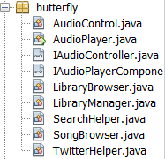
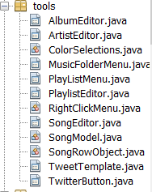
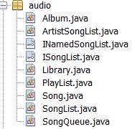
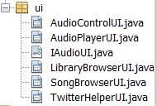
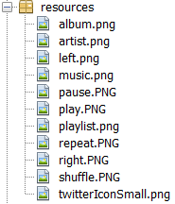
Implementation Progress
Butterfly is complete!

Slide 10
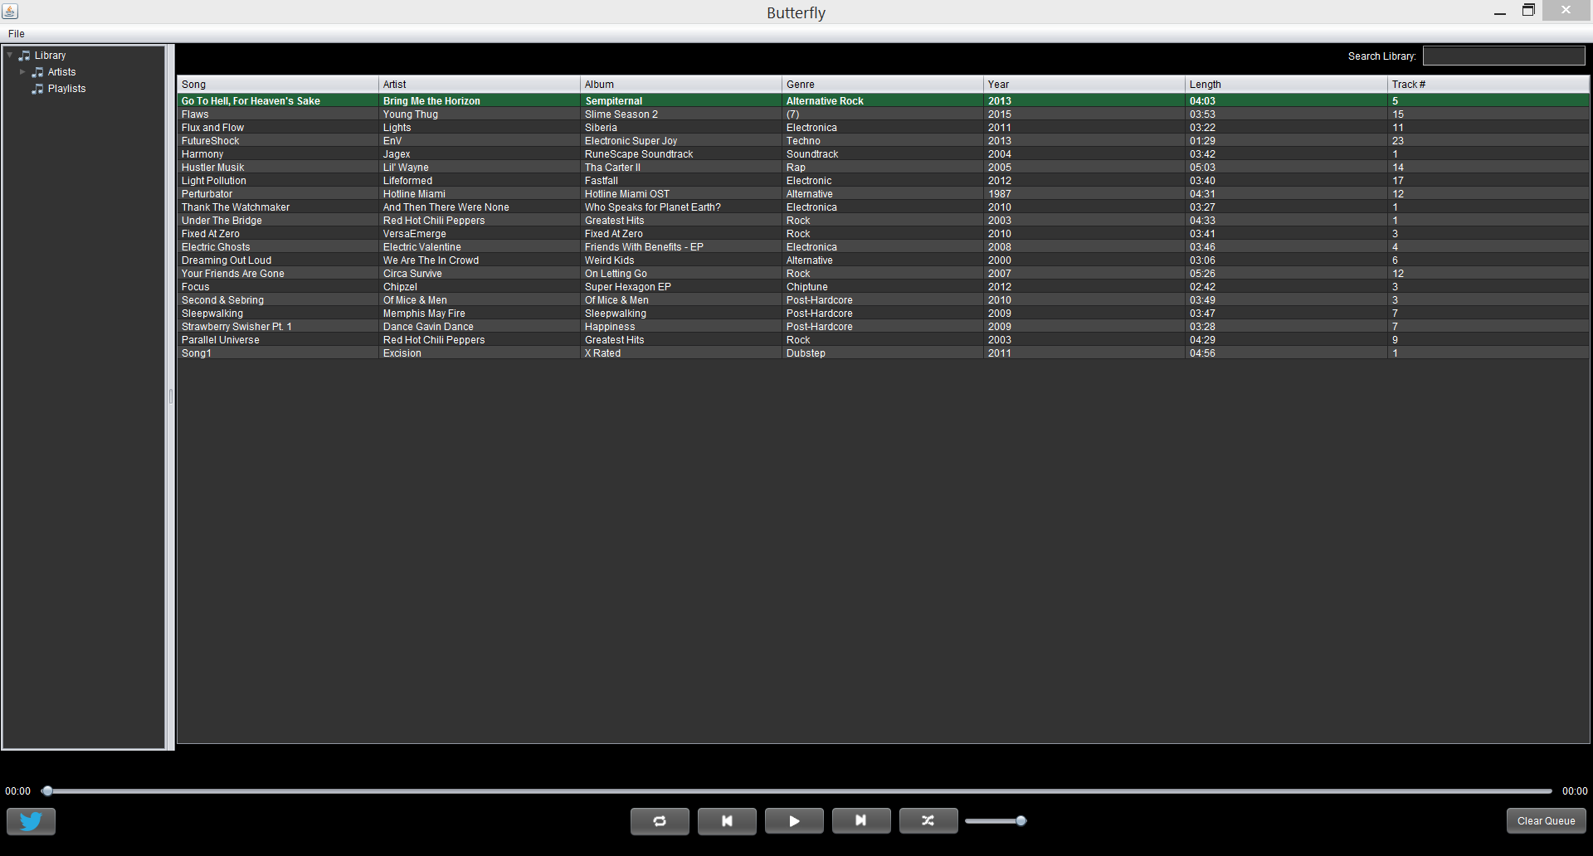
Butterfly Live Demo

Slide 11
Lessons Learned As a Team
It can be difficult to split work
Staying on top of documentation is important
Team members must compromise

